Slide 1
Bio 101
Lab 08: Forest Challenge
Name:
Seek Username:
NVCC Email:

Slide 2
Kingdom plantae
Kingdom plantae include
Green, brown and red algae
Liverworts
Mosses
Ferns
Seed plants without flowers
Seed plants with flowers

Slide 3
Characteristic of kingdom Plantae
They are multicellular organism.
Contain photosynthetic pigment
Non-motile and live anchored to a substrate
Reproduction is primarily asexual or sexual
Life cycle consists of alternating haploid gametophyte and diploid sporophyte

Slide 4
Analyzing type of plants
A. Napier grass
Common Name: Napier grass
Genus-Species Name: Pennisetum purpureum
Native or Introduced? Native
What color are the leaves? Green
Do these leaves have chlorophylls? Yes
Do these leaves have carotenoids? Yes
Do these leaves seem to have anthocyanin? yes

Slide 5
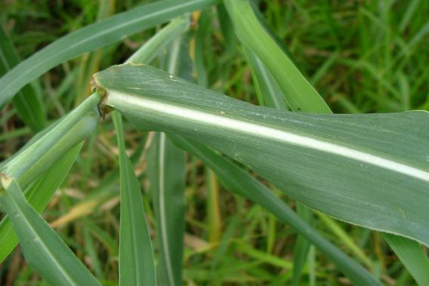
picture of the leaves of Napier glass

Slide 6
B. Rose Flower
Common Name: Rose flower
Genus-Species Name: Rosa
Native or Introduced? Native
What color are the leaves? green
Do these leaves have chlorophylls? Yes
Do these leaves have carotenoids? yes
Do these leaves seem to have anthocyanins? yes

Slide 7
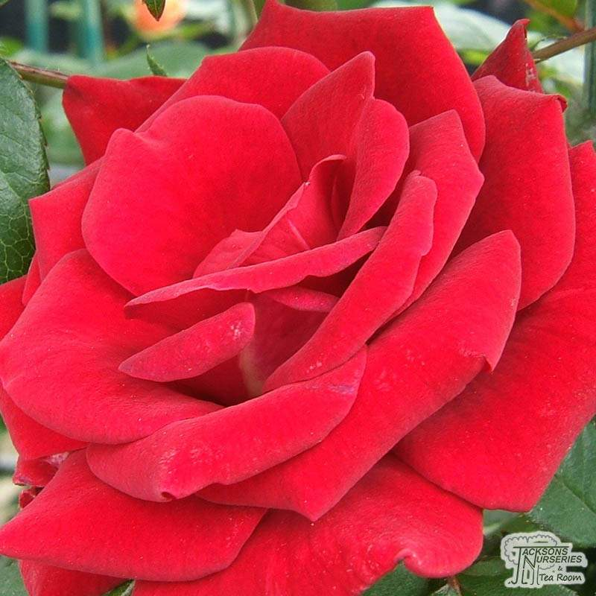
Rose flower and leafs

Slide 8
C. Jacaranda Tree
Common Name: Blue Jacaranda
Genus-Species Name: Jacaranda mimosifolia
Native or Introduced? Native
What color are the leaves? Green
Do these leaves have chlorophylls? Yes
Do these leaves have carotenoids? Yes
Do these leaves seem to have anthocyanin? Yes

Slide 9
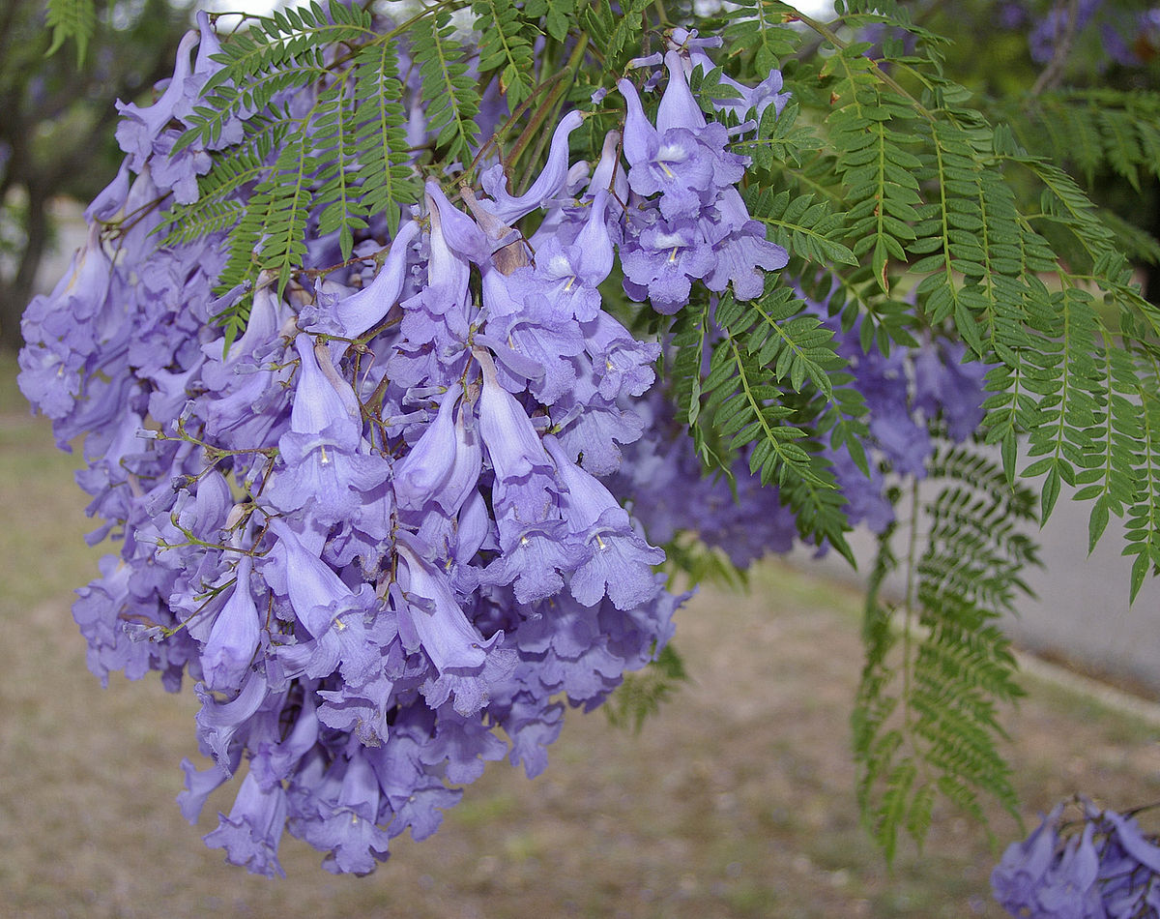
Picture of the Jacaranda leafs

